Slide 1
PA Compression Test Software Improvements for M/A-COM
Nick Lalic
VNA Software Developer
September 25th, 2015

Slide 2
PA Compression Test
Three logical parts:
Measurement (Power vs Frequency sweeps)
Plot generation
Data to Memory (Hold)

Slide 3
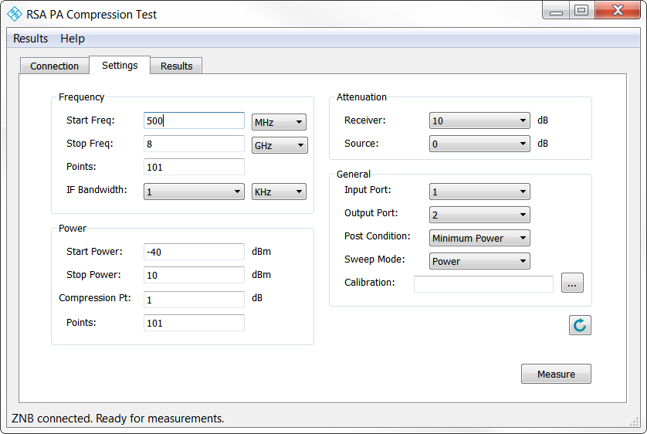
PA Compression Test
Measurement
Sweep power vs frequency
Stop at compression
Accommodate gain expansion
Accommodate pulsed power conditions

Slide 4
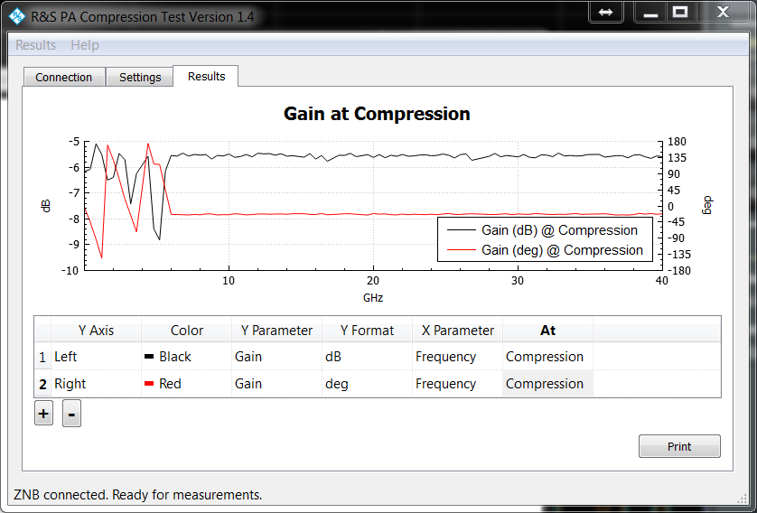
PA Compression Test
Plot Generation
Current results screen:

Slide 5
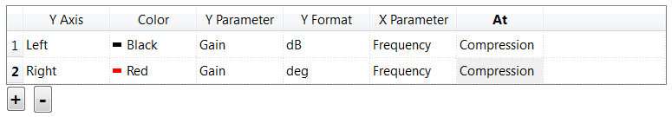
PA Compression Test
Plot Generation
Request: plots on VNA
Question: Are these trace settings sufficient?
Options:
Y Parameter: Input/Output Reflection, Gain, Reverse Gain, Pin, Pout
Y Format: dB, mag, deg, rad, VSWR, dBm
X Parameter: vs Frequency, vs Power
At: Maximum Gain, Compression, Specific Frequency, Specific Power

Slide 6
PA Compression Test
Plot Generation
Option 1 – Keep current plot selection tool, generate plots on VNA
Option 2 -

